Slide 1

Python Function

Slide 2
Contents
Built-in Function & User Defined Function
Function with Different Parameters
Local Scope
Global Scope
Python Standard Library

Slide 3
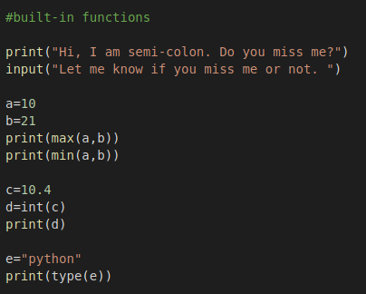
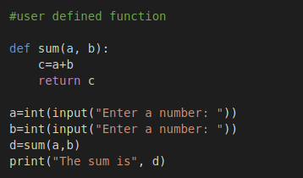
Built-in Function & User Defined Function
Built-in Function
User Defined Function

Slide 4
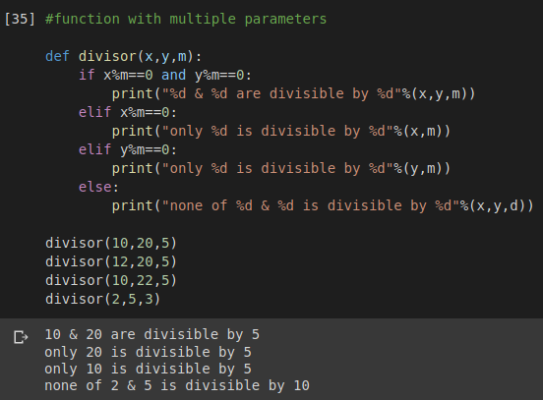
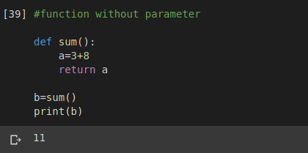
Function with Different Parameters
Multiple parameters
Without parameter

Slide 5
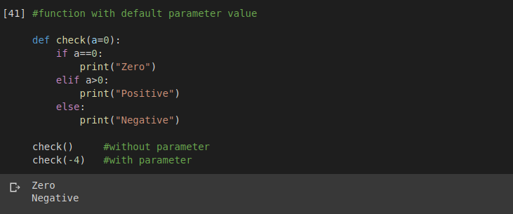
Function with Different Parameters
Default parameter value

Slide 6
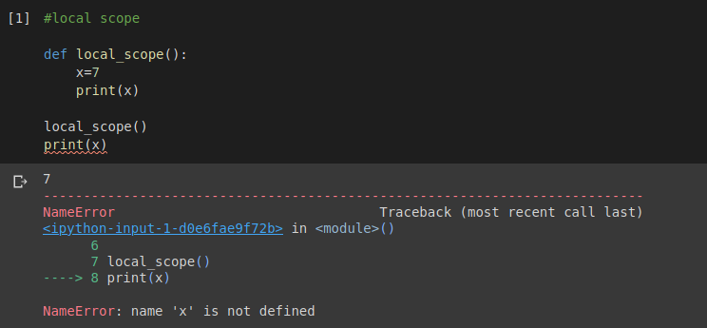
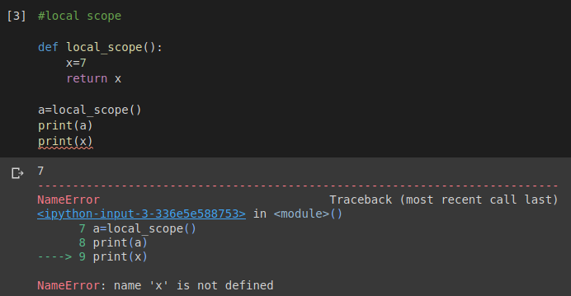
Local Scope
Tried to access local variable from outside of function and got error
We can get the value of local variable returned by the function.
But we can not get the variable outside of function

Slide 7
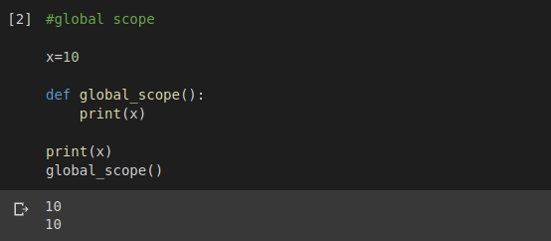
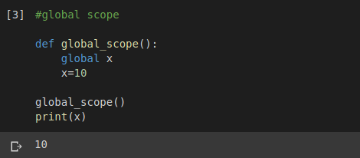
Global Scope
Global variable can be accessed from anywhere
Local variable with global keyword can be used as global variable

Slide 8
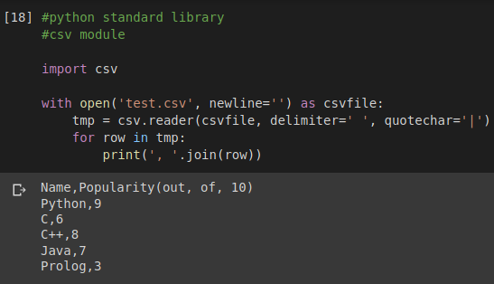
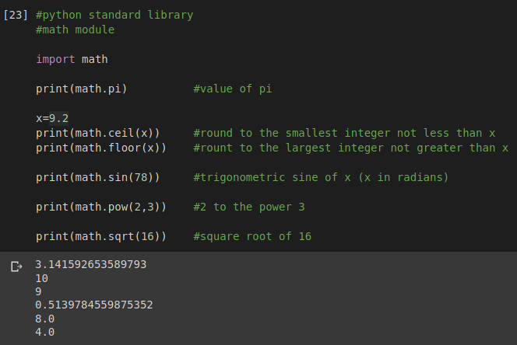
Python Standard Library
csv module
math module

Slide 9
Thank You

